Slide 1

Basic Algorithms
Recursion, Greedy, Sorting and Searching
SoftUni Team
Technical Trainers
Software University
https://softuni.bg

Slide 2
Table of Contents
Algorithms and Complexity
Recursion and Recursive Algorithms
Brute-Force Algorithms
Greedy Algorithms and Greedy Failure Cases
Sorting Algorithms
Selection Sort, Bubble Sort, QuickSort, MergeSort
Searching Algorithms
Linear Search and Binary Search

Slide 3
Have a Question?
sli.do
#csharp-advanced

Slide 4
O(n)
Algorithmic Complexity
Asymptotic Notation

Slide 5
Algorithm Analysis
Why should we analyze algorithms?
Predict the resources the algorithm will need
Computational time (CPU consumption)
Memory space (RAM consumption)
Communication bandwidth consumption
Hard disk operations
Other resources

Slide 6
Problem: Get Number of Steps
long GetOperationsCount(int n)
{
long counter = 0;
for (int i = 0; i < n; i++)
for (int j = 0; j < n; j++)
counter++;
return counter;
}
Solution:
T(n) = 3(n ^ 2) + 3n + 3
Calculate maximum steps to find the result
The input(n) of the function is the main source of steps growth

Slide 7
Simplifying Step Count
Some parts of the equation grow much faster than others
T(n) = 3(n²) + 3n + 3
We can ignore some part of this equation
Higher terms dominate lower terms – n > 2, n² > n, n³ > n²
Multiplicative constants can be omitted – 12n → n, 2n² → n²
The previous solution becomes ≈ n²

Slide 8
Time Complexity
Worst-case
An upper bound on the running time
Average-case
Average running time
Best-case
The lower bound on the running time (the optimal case)

Slide 9
Time Complexity
Therefore, we need to measure all the possibilities:

Slide 10
Time Complexity
From the previous chart we can deduce:
For smaller size of the input (n) we don't care much for the runtime
So we measure the time as n approaches infinity
If an algorithm must scale, it should compute the result within a finite and practical time
We're concerned about the order of an algorithm's complexity, not the actual time in terms of milliseconds

Slide 11
Asymptotic Notations
Descriptions that allow us to examine an algorithm's running time
There are three common asymptotic notations:
Big O – O(f(n))
Big Theta – Θ(f(n))
Big Omega – Ω(f(n))

Slide 12
Asymptotic Functions
Below are some examples of common algorithmic grow:

Slide 13
Typical Complexities
Complexity | Notation | Description
constant | O(1) | n = 1 000 → 1-2 operations
logarithmic | O(log n) | n = 1 000 → 10 operations
linear | O(n) | n = 1 000 → 1 000 operations
linearithmic | O(n*log n) | n = 1 000 → 10 000 operations
quadratic | O(n2) | n = 1 000 → 1 000 000 operations
cubic | O(n3) | n = 1 000 → 1 000 000 000 operations
exponential | O(n^n) | n = 10 → 10 000 000 000 operations

Slide 14

What is Recursion?
Recursion

Slide 15

What is Recursion?
A function or a method that calls itself one or more times until a specified condition is met
When the condition is met, the rest of each repetition is processed from the last one called to the first
15

Slide 16
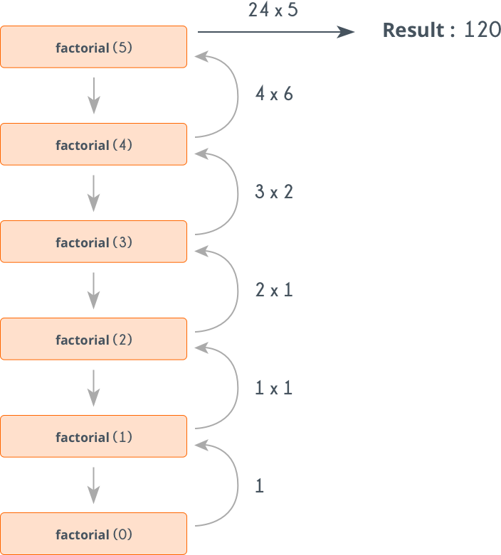
How Does It Work?
The function or method has a base case
Each step of the recursion should move towards the base case
16

Slide 17
Example: Array Sum
Sum(n - 1)
1
2 | 3 | 4
Sum(n)
Sum((n – 1) - 1)
1 | 2 | 3 | 4
1
2
3 | 4
Sum(((n – 1) - 1) – 1)
1
2
3
4
Base case

Slide 18
Problem: Recursive Array Sum
Write a recursive method that:
Finds the sum of all numbers stored in an int[] array
Read numbers from the console
1 2 3 4
10
-1 0 1
0

Slide 19
Solution: Recursive Array Sum
static int Sum(int[] array, int index)
{
if (index == array.Length - 1)
{
return array[index];
}
return array[index] + Sum(array, index + 1);
}

Slide 20
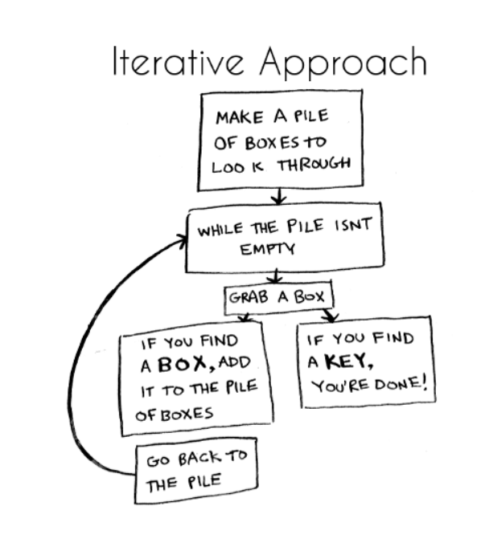
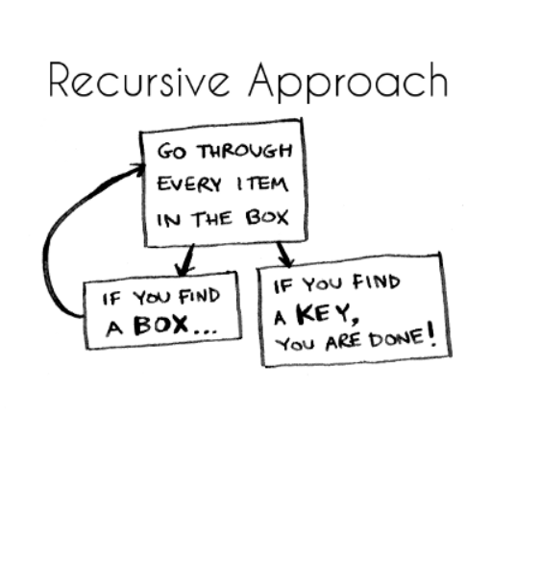
Iterative vs. Recursive Approach
A function repeats a defined process until a condition fails
A function that calls itself repeatedly until a certain condition is met
20

Slide 21
Example: Recursive Factorial
Recursive definition of n! (n factorial):
Pseudocode
N!
5
120
10
3628800
n! = n * (n–1)! for n > 0
0! = 1

Slide 22

Problem: Recursive Factorial
Create a recursive method that calculates n!
Read n from the console
5
120
10
3628800

Slide 23
Solution: Recursive Factorial
static long Factorial(int num)
{
if (num == 0)
{
return 1;
}
return num * Factorial(num - 1)
}
Base case

Slide 24
Recursion Pre-Actions and Post-Actions
Recursive methods have 3 parts:
Pre-actions (before calling the recursion)
Recursive calls (step-in)
Post-actions (after returning from recursion)
static void Recursion
{ // Pre-actions
Recursion();
// Post-actions }

Slide 25
Direct and Indirect Recursion
Direct recursion
A method directly calls itself
Indirect recursion
Method A calls B, method B calls A
Or even A → B → C → A
void A()
{
…
A();
}
void A() {
…
B();
}
void B() {
…
A();
}

Slide 26

Brute-Force Algorithms

Slide 27
Brute-Force Algorithms
Trying all possible combinations
Picking the best solution
Usually slow and inefficient
0
0
0
0
0

Slide 28
Brute-Force Algorithms
0
0
0
0
0

Slide 29
Brute-Force Algorithms
0
0
0
0
1

Slide 30
Brute-Force Algorithms
0
0
0
0
2

Slide 31
Brute-Force Algorithms
9
9
9
9
9
10 x 10 x 10 x 10 x 10 = 100,000 combinations

Slide 32

Greedy Algorithms

Slide 33
Greedy Algorithms
Greedy algorithms assume that always choosing a local optimum leads to the global optimum
Can produce a non-optimal (incorrect) result
It is used in optimization problems as well
Find the shortest path from Sofia to Varna
Find the maximum increasing subsequence
33

Slide 34

Live Demo
Greedy Algorithms

Slide 35
Problem: Sum of Coins
Write a program, which gathers a sum of money, using the least possible number of coins
Consider the US currency coins
0.01, 0.02, 0.05, 0.10
Greedy algorithm for "Sum of Coins":
Take the largest coin while possible
Then take the second largest
Etc.
1$
1¢
50¢
5¢
25¢
4¢

Slide 36
Sum of Coins Visualization
Target: 18
10¢
5¢
2¢
1¢
10¢
5¢
2¢
1¢
Actual:
0

Slide 37
Sum of Coins Visualization
Target: 18
10¢
5¢
2¢
1¢
5¢
2¢
1¢
Actual:
10
10¢

Slide 38
Sum of Coins Visualization
Target: 18
10¢
5¢
2¢
1¢
2¢
1¢
Actual:
15
10¢
5¢

Slide 39
Sum of Coins Visualization
Target: 18
10¢
5¢
2¢
1¢
1¢
Actual:
17
10¢
5¢
2¢

Slide 40
Sum of Coins Visualization
Target: 18
10¢
5¢
2¢
1¢
Actual:
18
10¢
5¢
2¢
1¢

Slide 41

Greedy Failure Cases

Slide 42
Sum of Coins Failure
Target: 18
10¢
5¢
4¢
1¢
10¢
5¢
4¢
1¢
10¢
5¢
4¢
1¢
Actual:
0

Slide 43
Sum of Coins Failure
Target: 18
10¢
5¢
4¢
1¢
10¢
5¢
4¢
1¢
5¢
4¢
1¢
Actual:
10
10¢

Slide 44
Sum of Coins Failure
Target: 18
10¢
5¢
4¢
1¢
10¢
5¢
4¢
1¢
4¢
1¢
Actual:
15
10¢
5¢

Slide 45
Sum of Coins Failure
Target: 18
10¢
5¢
4¢
1¢
10¢
5¢
4¢
1¢
4¢
Actual:
16
10¢
5¢
1¢

Slide 46
Sum of Coins Failure
Target: 18
10¢
5¢
4¢
1¢
10¢
5¢
4¢
4¢
Actual:
17
10¢
5¢
1¢
1¢

Slide 47
Sum of Coins Failure
Target: 18
10¢
5¢
4¢
10¢
5¢
4¢
4¢
Actual:
18
10¢
5¢
1¢
1¢
1¢

Slide 48
Sum of Coins Failure
Target: 18
10¢
5¢
1¢
1¢
1¢
10¢
4¢
4¢

Slide 49
Solution: Sum of Coins (1)
int finalSum = 18;
int currentSum = 0;
int[] coins = { 10, 10, 5, 5, 2, 2, 1, 1 };
Queue<int> resultCoins = new Queue<int>();
// Next slide
Console.WriteLine("Sum not found");

Slide 50
Solution: Sum of Coins (2)
for (int i = 0; i < coins.Length; i++)
{
if (currentSum + coins[i] > finalSum) continue;
currentSum += coins[i];
resultCoins.Enqueue(coins[i]);
if (currentSum == finalSum)
// Sum found
}

Slide 51
Problem: Set Cover
Write a program that finds the smallest subset of S, the union of which = U (if it exists)
You will be given a set of integers U called "the Universe"
And a set S of n integer sets whose union = U
Universe: 1, 2, 3, 4, 5
Number of sets: 4
1, 4
2, 4
5, 2
3
Sets to take (3):
{ 1, 4 }
{ 5, 2 }
{ 3 }

Slide 52
Solution: Set Cover (1)
public static List<int[]> ChooseSets(List<int[]> sets, List<int> universe)
{
List<int[]> selectedSets = new List<int[]>();
while (universe.Count > 0)
{
// Next slide
}
return selectedSets;
}

Slide 53
Solution: Set Cover (2)
int[] current = sets.OrderByDescending(set => set.Count(universe.Contains)).First();
selectedSets.Add(current);
sets.Remove(current);
foreach (int i in current)
{
universe.Remove(i);
}

Slide 54

Simple Sorting Algorithms

Slide 55

What is a Sorting Algorithm?
An algorithm that rearranges elements in a set in a specific order
The elements must be comparable
Sorting algorithms
Insertion, Exchange (Bubble sort and Quicksort), Selection (Heapsort), Merging, Serial/Parallel, etc.
Unsorted list
Sorted list
10 | 3 | 7 | 3 | 4
3 | 3 | 4 | 7 | 10
55

Slide 56
Sorting Algorithms: Classification
Sorting algorithms are often classified by
Computational complexity and memory usage
Worst, average and best-case behavior
Recursive / non-recursive
Stability – stable / unstable
Comparison-based sort / non-comparison based
Fun fact - Bogosort is highly inefficient sorting algorithm with two versions
Deterministic version that enumerates all permutations until it hits a sorted one
Randomized version that randomly permutes its input

Slide 57
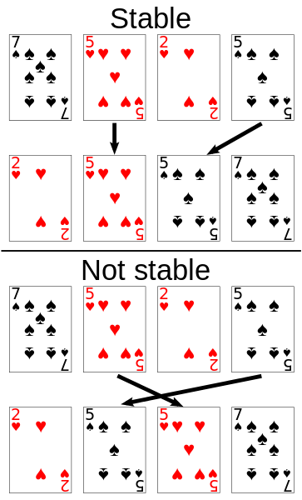
Stability of Sorting
Stable sorting algorithms
Maintain the order of equal elements
If two items compare as equal, their relative order is preserved
Unstable sorting algorithms
Rearrange the equal elements in unpredictable order
Often different elements have the same key used for equality comparing

Slide 58
Selection Sort
Selection sort – simple, but inefficient algorithm (visualize)
Swap the first with the min element on the right, then the second, etc.
Memory: O(1)
Stable: No
Method: Selection

Slide 59
Selection Sort: Why Unstable?
Why the "selection sort" is unstable?
Swaps the first element with the min element on the right
Swaps the second element with the min element on the right
Etc.
During the swaps equal elements can jump over each other
left
min
swap
equal elements
changed order
3♥ | 5♠ | 3♦ | 4♥ | 2♣
3♥ | 5♠ | 3♦ | 4♥ | 2♣
2♣ | 5♠ | 3♦ | 4♥ | 3♥

Slide 60
Selection Sort Code
for (int index = 0; index < collection.Length; index++)
{
int min = index;
for (int curr = index + 1; curr < collection.Length; curr++)
{
if (Less(collection[curr], collection[min]))
{
min = curr;
}
}
Swap(collection, index, min);
}

Slide 61
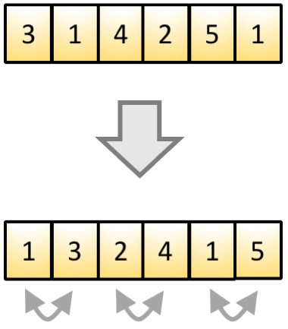
Bubble Sort
Bubble sort – simple, but inefficient algorithm (visualize)
Swaps to neighbor elements when not in order until sorted
Memory: O(1)
Stable: Yes
Method: Exchanging

Slide 62
Example: Bubble Sort
int[] numbers = { 1, 3, 4, 2, 5, 6 };
for (int i = 0; i < numbers.Length; i++)
{
for (int j = i + 1; j < numbers.Length - 1; j++)
{
if (numbers[i] > numbers[j]) {
int tempNumber = numbers[i];
numbers[i] = numbers[j];
numbers[j] = tempNumber; }
}
}
Console.WriteLine(string.Join(" ", numbers));

Slide 63
Comparison of Sorting Algorithms
Name | Best | Average | Worst | Memory | Stable | Method
Selection | n² | n² | n² | 1 | No | Selection
Bubble | n | n² | n² | 1 | Yes | Exchanging

Slide 64
Quick Sort
QuickSort – efficient sorting algorithm
Choose a pivot; move smaller elements left & larger right; sort left & right
Memory: O(log(n)) stack space (recursion)
Time: O(n²)
Stable: Depends
Method: Partitioning

Slide 65
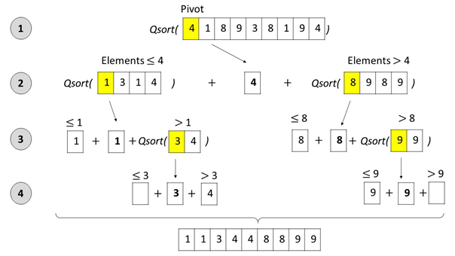
Quick Sort: Conceptual Overview

Slide 66
Quick Sort (1)
public static void QuickSortHelper(
int[] array, int startIdx, int endIdx)
{
if (startIdx >= endIdx)
return;
var pivotIdx = startIdx;
var leftIdx = startIdx + 1;
var rightIdx = endIdx;
while (leftIdx <= rightIdx) {
// TODO: Continues on the next slide
}
// TODO: Continues on slide Quick Sort (3)
}

Slide 67
Quick Sort (2)
if (array[leftIdx] > array[pivotIdx] &&
array[rightIdx] < array[pivotIdx]) {
Swap(array, leftIdx, rightIdx);
}
if (array[leftIdx] <= array[pivotIdx]) {
leftIdx += 1;
}
if (array[rightIdx] >= array[pivotIdx]) {
rightIdx -= 1;
}

Slide 68
Quick Sort (3)
Swap(array, pivotIdx, rightIdx);
var isLeftSubArraysSmaller =
rightIdx - 1 - startIdx < endIdx - (rightIdx + 1);
if (isLeftSubArraysSmaller) {
QuickSortHelper(array, startIdx, rightIdx - 1);
QuickSortHelper(array, rightIdx + 1, endIdx);
} else {
QuickSortHelper(array, rightIdx + 1, endIdx);
QuickSortHelper(array, startIdx, rightIdx - 1);
}

Slide 69
Comparison of Sorting Algorithms
Name | Best | Average | Worst | Memory | Stable | Method
Selection | n² | n² | n² | 1 | No | Selection
Bubble | n | n² | n² | 1 | Yes | Exchanging
Quick | n * log(n) | n * log(n) | n² | 1 | Depends | Partitioning

Slide 70
Merge Sort
Merge sort is efficient sorting algorithm
Divide the list into sub-lists (typically 2 sub-lists)
Sort each sub-list (recursively call merge-sort)
Merge the sorted sub-lists into a single list
Memory: O(n) / O(n*log(n))
Time: O(n*log(n))
Highly parallelizable on multiple cores / machines → up to O(log(n))

Slide 71
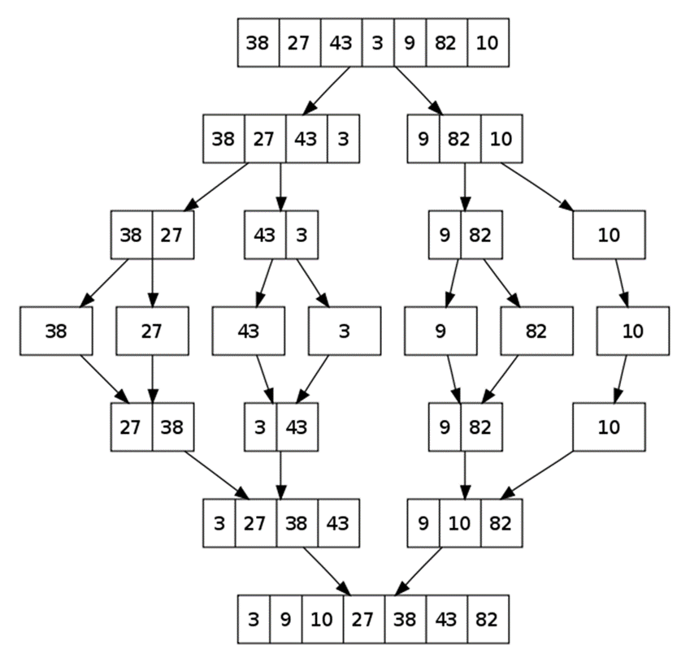
Merge Sort: Conceptual Overview

Slide 72
Merge Sort (1)
// Memory: O(n*log(n))
public static int[] MergeSort(int[] array)
{
if (array.Length == 1)
return array;
var middleIdx = array.Length / 2;
var leftHalf = array.Take(middleIdx).ToArray();
var rightHalf = array.Skip(middleIdx).ToArray();
return MergeArrays(MergeSort(leftHalf), MergeSort(rightHalf));
}

Slide 73
Merge Sort (2)
public static int[] MergeArrays(int[] left, int[] right) {
var sorted = new int[left.Length + right.Length];
var sortedIdx = 0; var leftIdx = 0; var rightIdx = 0;
while (leftIdx < left.Length && rightIdx < right.Length) {
if (left[leftIdx] < right[rightIdx]) {
sorted[sortedIdx++] = left[leftIdx++];
} else {
sorted[sortedIdx++] = right[rightIdx++];
}
}
// TODO: Take remaining elements either from the left or right
return sorted;
}

Slide 74
Merge Sort (3)
while (leftIdx < left.Length) {
sorted[sortedIdx] = left[leftIdx];
sortedIdx += 1;
leftIdx += 1;
}
while (rightIdx < right.Length) {
sorted[sortedIdx] = right[rightIdx];
sortedIdx += 1;
rightIdx += 1;
}

Slide 75
Merge Sort
// Memory: O(n)
public static int[] MergeSort(int[] array)
{
if (array.Length <= 1)
return array;
var copy = new int[array.Length];
Array.Copy(array, copy, array.Length);
MergeSortHelper(array, copy, 0, array.Length - 1);
return array;
}

Slide 76
Merge Sort (2)
public static void MergeSortHelper(
int[] source, int[] copy, int leftIdx, int rightIdx)
{
if (leftIdx >= rightIdx)
return;
var middleIdx = (leftIdx + rightIdx) / 2;
MergeSortHelper(copy, source, leftIdx, middleIdx);
MergeSortHelper(copy, source, middleIdx + 1, rightIdx);
MergeArrays(source, copy, leftIdx, middleIdx, rightIdx);
}

Slide 77
Merge Sort (3)
public static void MergeArrays(
int[] source, int[] copy, int startIdx, int middleIdx, int endIdx) {
var sourceIdx = startIdx;
var leftIdx = startIdx; var rightIdx = middleIdx + 1;
while (leftIdx <= middleIdx && rightIdx <= endIdx) {
if (copy[leftIdx] < copy[rightIdx])
source[sourceIdx++] = copy[leftIdx++];
else
source[sourceIdx++] = copy[rightIdx++];
}
// TODO: Take remaining elements either from the left or right
}

Slide 78
Merge Sort (4)
while (leftIdx <= middleIdx)
{
source[sourceIdx] = copy[leftIdx];
leftIdx += 1;
sourceIdx += 1;
}
while (rightIdx <= endIdx)
{
source[sourceIdx] = copy[rightIdx];
rightIdx += 1;
sourceIdx += 1;
}

Slide 79
Comparison of Sorting Algorithms
Name | Best | Average | Worst | Memory | Stable | Method
Selection | n² | n² | n² | 1 | No | Selection
Bubble | n | n² | n² | 1 | Yes | Exchanging
Quick | n * log(n) | n * log(n) | n² | 1 | Depends | Partitioning
Merge | n * log(n) | n * log(n) | n * log(n) | 1 | Yes | Merging

Slide 80

Searching Algorithms

Slide 81
Search Algorithm
An algorithm for finding an item with specified properties among a collection of items
Typically answers either True or False to whether the item is present
It may return where the item is found
81

Slide 82
Linear Search
Linear search finds a particular value in a list (visualize)
Searches the whole sequence
Checks every element one at a time
Searches until the desired one is found
Worst and average performance: O(n)
for each item in the list:
if that item has the desired value,
return the item's location
return nothing

Slide 83
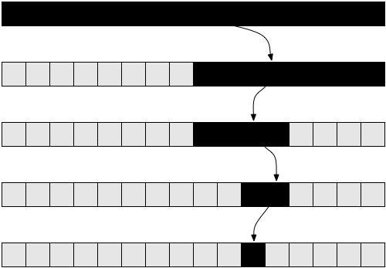
Binary Search
Binary search finds an item within a ordered data structure
At each step, compare the input with the middle element
The algorithm repeats its action to the left or right sub-structure
See the visualization
Complexity: O(log n)

Slide 84
Example: Binary Search (Iterative)
int BinarySearch(int arr[], int key, int start, int end)
{
while (end >= start) {
int mid = (start + end) / 2;
if (arr[mid] < key)
start = mid + 1;
else if (arr[mid] > key)
end = mid - 1;
else
return mid; }
return KEY_NOT_FOUND;
}

Slide 85

Summary
Algorithm Complexity – steps to execute: O(1), O(log n), O(n), O(n * log n), O(n^2), O(n^3), …
Recursion – a function calls itself
Brute-Force - trying all the possible solutions
Greedy - picking a locally optimal solution
Sorting
Slow algorithms: Selection and Bubble Sort
Fast algorithms: Quick and Merge Sort
Searching
Linear and Binary
…
…
…

Slide 86
Questions?
Notes:
86

Slide 87












SoftUni Diamond Partners

Slide 88


Educational Partners

Slide 89
Trainings @ Software University (SoftUni)
Software University – High-Quality Education, Profession and Job for Software Developers
softuni.bg, about.softuni.bg
Software University Foundation
softuni.foundation
Software University @ Facebook
facebook.com/SoftwareUniversity
Software University Forums
forum.softuni.bg
89
Notes:
89

Slide 90

License
This course (slides, examples, demos, exercises, homework, documents, videos and other assets) is copyrighted content
Unauthorized copy, reproduction or use is illegal
© SoftUni – https://about.softuni.bg/
© Software University – https://softuni.bg
Notes:
90

